Slide 1
File Systems, Database and Database Management Systems
CSIT882: Data Management Systems
Notes:
<!-- Neural, Brian, Male, British English. -->
<speak>
<break time="0.5s"/>
<prosody rate="90%">
Database and database management systems.
This presentation explains the concepts of file systems, database systems, and database management systems.
<break time="0.5s"/>
</prosody>
</speak>
Systems Analysis

Slide 2
Outline
File Systems
Database Systems
Database Management System
Notes:
<!-- Neural, Brian, Male, British English. -->
<speak>
<break time="0.5s"/>
<prosody rate="90%">
File systems.
</prosody>
</speak>
Systems Analysis

Slide 3
File systems
A data block-based logical model of persistent storage is too simplistic for more advanced data processing applications
A sequence of data blocks is partitioned into the variable [ˈveriəbl] subsequence of data blocks called as files and the names associated with the files uniquely identify each file
A file is a collection of records
A record can be stored in one or more data blocks and data block can contain a number of records
A record is a sequence of fields
A field is a pair [address, value] where a value is implemented as sequences of bytes located in a data block and address consists of file name, block number, and offset within a block
A file definition determines the names of fields and length of each field
Notes:
<!-- Neural, Brian, Male, British English. -->
<speak>
<break time="0.5s"/>
<prosody rate="90%">
An access to the individual data blocks using the random read and write data block operations, is the fastest way how data can be saved to and retrieved from persistent storage.
<break time="0.3s"/>
However, a logical model of persistent storage as a sequence of data blocks introduced in the previous video clip is too simplistic for more advanced data processing applications.
<break time="0.3s"/>
Typically, a sequence of data blocks is partitioned into variable sub-sequences of data blocks called as files, and the names associated with the files uniquely identify each file.
<break time="0.3s"/>
A file is a collection of records.
<break time="0.3s"/>
A record can be stored in one or more data blocks and a data block can contain several of records
<break time="0.3s"/>
A record is a sequence of fields.
<break time="0.3s"/>
A field is a pair: [address, value] where value is implemented as sequences of bytes located in a data block and address consists of file name, block number, offset within a block
<break time="0.3s"/>
A file definition determines the names of fields and length of each field
<break time="0.3s"/>
</prosody>
</speak>
Systems Analysis

Slide 4
File systems
Operations on files:
- open file
- close file
- read/write a record at a given address
- read/write the next record
Example of a simple ENROLMENTS file system
STUDENT file
STUDENT(number, first-name, last-name, date-of-birth, degree)
SUBJECT file
SUBJECT(code, title, credits)
ENROLMENT file
ENROLMENT(student-number, subject-code, enrolment-date, status)
Notes:
<!-- Neural, Brian, Male, British English. -->
<speak>
<break time="0.5s"/>
<prosody rate="95%">
A typical procedural programming language like Java, C++, Python, and the others, provides implementation of the following operations on the files.
<break time="0.3s"/>
A programmer can open a file and close a file when processing is no longer needed.
<break time="0.3s"/>
A programmer can read write a record at a given record address.
<break time="0.3s"/>
A programmer can read write a record at the current record address and move the current record address to the next record.
<break time="0.3s"/>
Information about the students, subjects and enrolments of the subjects by the students can be stored in the following files.
<break time="0.3s"/>
A student file contains the records with information about the students.
<break time="0.3s"/>
A student record consists of student number, first name, last name, date of birth and a degree enrolled by a student.
<break time="0.3s"/>
A subject file contains the records with information about the subject available for enrolment.
<break time="0.3s"/>
A subject record consists of subject code, title of subject and the total number of credits as subject is worth of.
<break time="0.3s"/>
An enrolment file contains the records with information about the enrolments performed by the students.
<break time="0.3s"/>
An enrolment record consists of student number, code of subject enrolled by a student, enrolment date, and a status of enrolment.
<break time="0.3s"/>
</prosody>
</speak>
Systems Analysis

Slide 5
File systems
Limitations of file systems
- Separation and isolation of data:The meaning of the data is defined in the application software. (Nonlogical independance)
- Data redundancy
- Incompatible formats of files
- Fixed queries/proliferation [prəˌlɪfəˈreɪʃn] of application programs
- No provision for security or integrity
- No recovery from hardware or software failures
- No provision for shared access
Notes:
<!-- Neural, Brian, Male, British English. -->
<speak>
<break time="0.5s"/>
<prosody rate="90%">
File systems have a number of limitations.
<break time="0.3s"/>
File systems separate and isolate data.
It means, that data is not associated in the files with its interpretation.
For example, interpretation of a sequence of four bytes stored in a file depends on software that processes a file.
<break time="0.3s"/>
File system are usually redundant.
It is possible that the same information is replicated in many files and there are no mechanisms that can detect and eliminate the redundancies.
<break time="0.3s"/>
File systems may have incompatible formats of data.
In one file an integer number can be represented as a sequence of four bytes while in another file an integer can be represented as a sequence of eight bytes.
Incompatible formats of data lead to incompatible formats of files.
<break time="0.3s"/>
The next problems is fixed queries proliferation of application programs.
It means, that file systems do not have a universal query language that can be used to create any query operating in the same way on different files.
Each new query needs implementation of a new piece of software.
There are no mechanisms for quick creation of ad-hoc queries.
The users must wait for some time while a request to access data is implemented by an application programmer.
<break time="0.3s"/>
File systems have pretty simplistic model for security and no mechanisms to enforce data integrity.
<break time="0.3s"/>
File systems do not have any mechanism to recover data after hardware or software failures.
<break time="0.3s"/>
File system do not control concurrent access to data shared by many users in more or less the same period of time.
Apart from locking of entire file there are no more sophisticated mechanisms for concurrent access control.
</prosody>
</speak>
Systems Analysis

Slide 6
Outline
File Systems
Database Systems
Database Management System
Notes:
<!-- Neural, Brian, Male, British English. -->
<speak>
<break time="0.5s"/>
<prosody rate="90%">
Database systems
</prosody>
</speak>
Systems Analysis

Slide 7
Database systems
Database systems eliminate a number of important limitations of file systems:
- Database systems store the definitions of data stored together with data
Database systems provide a universal query language that can used for quick implementation of ad-hoc access to data
Database systems implement a standard and unified collection of different types of data, like for example, integer, float, string, date, and the others
Database systems provide the mechanism to enforce security and integrity of data
Database systems implement the mechanism to automatically restore data after hardware or software failures
Database systems implement the mechanism for shared and concurrent access to data by many different users
Notes:
<!-- Neural, Brian, Male, British English. -->
<speak>
<break time="0.5s"/>
<prosody rate="90%">
Database systems eliminate a number of important limitations of file systems:
<break time="0.3s"/>
Database systems store the definitions of data stored together with data.
<break time="0.3s"/>
Database systems provide a universal query language that can be used for quick implementation of ad-hoc access to data.
<break time="0.3s"/>
Database systems implement a standard and unified collection of different types of data, like for example, integer, float, string, date, and the others.
<break time="0.3s"/>
Database systems provide the mechanism to enforce security and integrity of data.
<break time="0.3s"/>
Database systems implement the mechanisms, that automatically restore data after hardware or software failures.
<break time="0.3s"/>
Database systems implement the mechanisms, that allow for concurrent and shared access to data by many different users.
<break time="0.3s"/>
</prosody>
</speak>
Systems Analysis

Slide 8
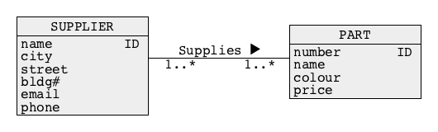
Database systems
A database is a shared collection of logically related data designed to meet the information needs of an organization
We can also say that at a higher level of abstraction a database is a description of selected fragment of the reality
A database may have different views at a conceptual (abstract) level and at a logical level
Usually, at a conceptual level (abstract level) a database is a collection of objects (entities) described by the values of properties (attributes) and related to each other through associations (relationships), for example, see a diagram below that represent “suppliers” and “parts” (objects) and an association “supplies” that links “suppliers” and “parts”
Notes:
<!-- Neural, Brian, Male, British English. -->
<speak>
<break time="0.5s"/>
<prosody rate="90%">
A database, is a shared collection of logically related data designed to meet the information needs of an organization.
<break time="0.3s"/>
We can also say that at a higher level of abstraction a database is a description of selected fragment of the reality.
<break time="0.3s"/>
A database, may have different views at a conceptual (abstract) level, and at a logical level.
<break time="0.3s"/>
Usually, at a conceptual level (abstract level) a database, is a collection of objects (entities) described by the values of properties (attributes) and related to each other through associations (relationships).
For example, see a diagram below that represent “suppliers” and “parts” (objects) and an association “supplies” that links “suppliers” and “parts”
<break time="0.3s"/>
</prosody>
Systems Analysis

Slide 9
Database systems
Usually, at a logical level, a database is visible to the users as a collection of tables, where a table consist of a header with attribute names, and the rows with the respective values of attributes
It is also possible, that at a logical level a database is visible to the users as a collection of records linked with pointers or as a collection of hierarchical structures
Example of a conceptual view of a database:
- A database contains information about suppliers, parts, and shipments of parts done by suppliers
- A conceptual schema:
Notes:
<!-- Neural, Brian, Male, British English. -->
<speak>
<break time="0.5s"/>
<prosody rate="90%">
Usually, at a logical level, a database is visible to the users as a collection of tables, where a table consist of a header with the attribute names, and the rows with the respective values of attributes.
<break time="0.3s"/>
It is also possible that at a logical level, a database is visible to the users as a collection of records linked with pointers, or as a collection of hierarchical structures.
<break time="0.3s"/>
For example, consider a conceptual view a database from the previous slide, where a database contains information about suppliers involved in shipments of parts.
At a conceptual level a supplier is described by a name, address, that consists of city name, street name, building number, and by an email address and phone number.
A part is described by a number, name, colour, and price,
An association "supplies", links the suppliers and parts supplied by suppliers.
<break time="0.3s"/>
</prosody>
</speak>
Systems Analysis

Slide 10
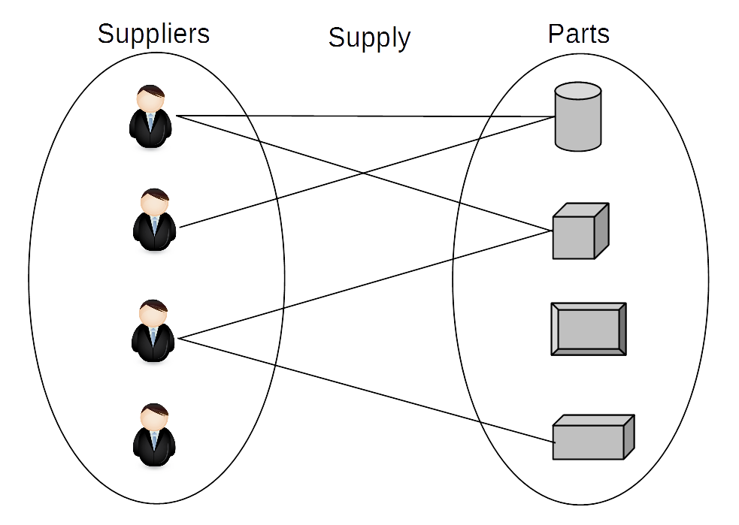
Database systems
Sample conceptual view of a database:
- A database contains information about suppliers, parts, and shipments of parts done by suppliers
- An instance diagram:
Notes:
<!-- Neural, Brian, Male, British English. -->
<speak>
<break time="0.5s"/>
<prosody rate="90%">
At a conceptual level, a database, that contains information about parts and suppliers consists of instances of objects and links between the objects.
<break time="0.3s"/>
For example, a diagram below visualizes four suppliers, and four parts, and the links between parts and suppliers.
<break time="0.3s"/>
One of the suppliers does not supply any parts at the moment, two suppliers supply two parts, and one supplier supplies only one part.
<break time="0.3s"/>
One of the parts is not supplied by any supplier.
<break time="0.3s"/>
One part has one supplier, and the remaining two parts have two suppliers.
<break time="0.3s"/>
A diagram that visualizes the contents of a database at a conceptual level is called as, an instance diagram.
</prosody>
Systems Analysis

Slide 11
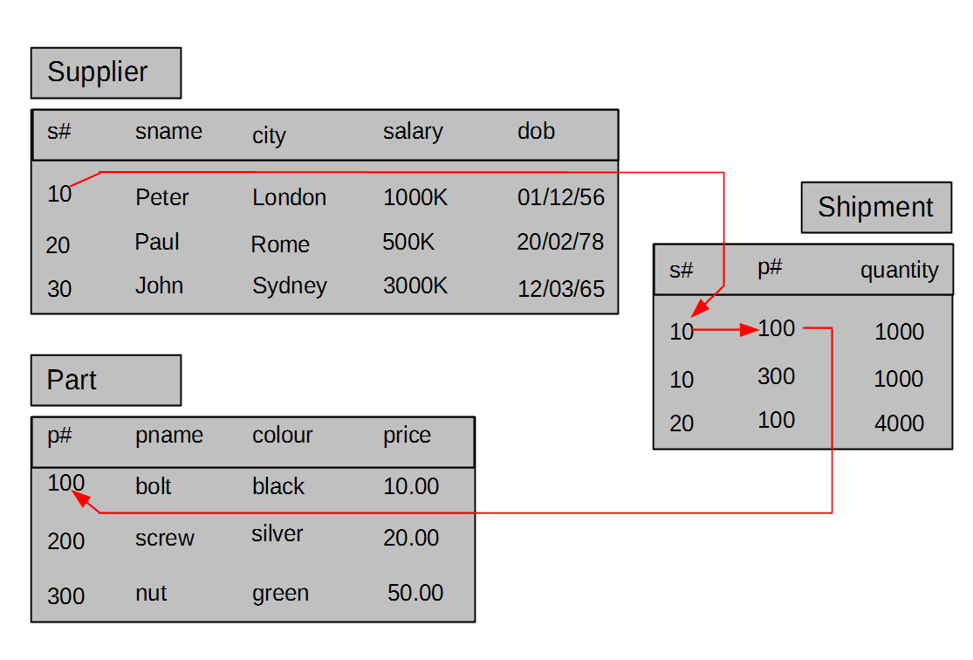
Database systems
Example of a logical view of a database:
- A database contains information about suppliers, parts, and shipments of parts done by suppliers
A logical view above is also called as a tabular [ˈtæbjələr] view of data
Notes:
<!-- Neural, Brian, Male, British English. -->
<speak>
<break time="0.5s"/>
<prosody rate="90%">
One of the most frequently used logical views of a database is, a tabular view.
<break time="0.3s"/>
A tabular view of a database, that contains information about suppliers, parts, and shipments of parts by supplier consists of three tables.
<break time="0.3s"/>
One of the tables contains information about suppliers.
A row in such table contains the values of attributes describing one supplier.
<break time="0.3s"/>
The other table contains information about the parts supplied by suppliers.
Like in the previous case, a row in part table contains the values of attributes describing one part.
<break time="0.3s"/>
The third table contains information about the links between parts and suppliers.
A row in such table implements a single link, that at conceptual level represents a fact that a supplier supplies a part.
<break time="0.5s"/>
</prosody>
</speak>
Systems Analysis

Slide 12
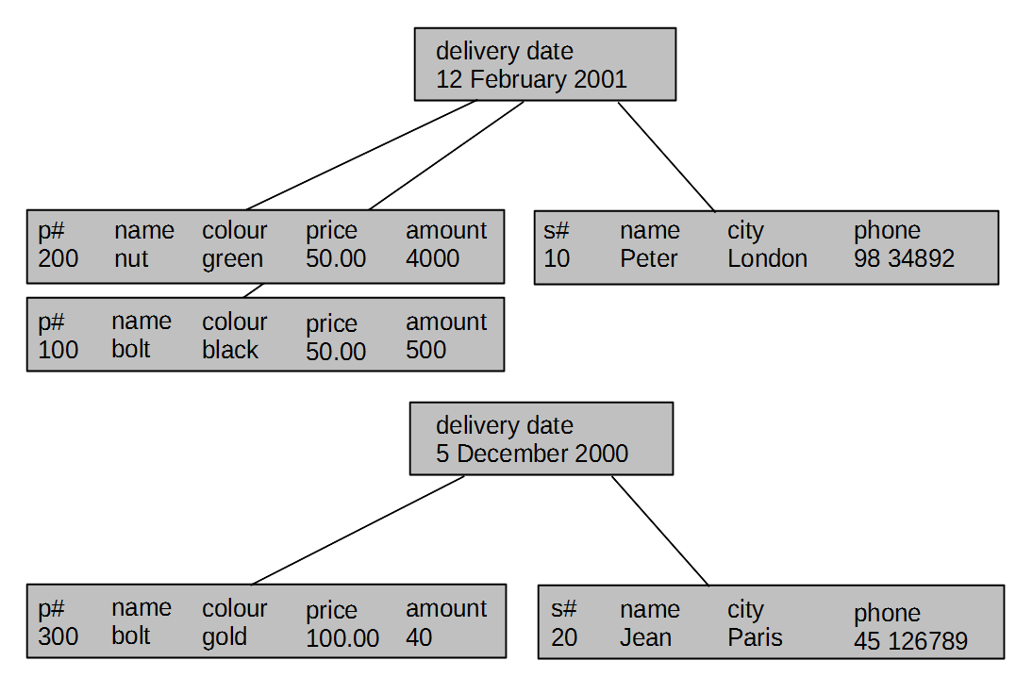
Database systems
Another example of a logical view of a database:
- A database contains information about suppliers, parts , and shipments of parts done by suppliers
A logical view above is also called as a hierarchical view of data
Notes:
<!-- Brian, Male, British English -->
<speak>
<break time="0.5s"/>
<prosody rate="90%">
Another logical view of database contents, is a hierarchical view.
<break time="0.3s"/>
When a hierarchical data model is used, the contents of a database is visible to the users as a collection of hierarchies of records.
<break time="0.3s"/>
For example, the records representing shipment information, could be the roots of hierarchies over supplier and part records, as it is visualized on a picture below.
<break time="0.3s"/>
Unfortunately, a hierarchical model of data alone is not sufficient to represent any conceptual view of data.
<break time="0.3s"/>
Using only a hierarchical view leads to the redundancies when the representation of many-to-many associations is required by a conceptual view.
<break time="0.3s"/>
For example, if the same supplier supplies many parts then a description of such supplier is repeated with each shipment performed.
<break time="0.3s"/>
To eliminate the redundancies we need the links between the hierarchies, and it leads to another logical view view of the database contents.
<break time="0.5s"/>
</prosody>
</speak>
Systems Analysis

Slide 13
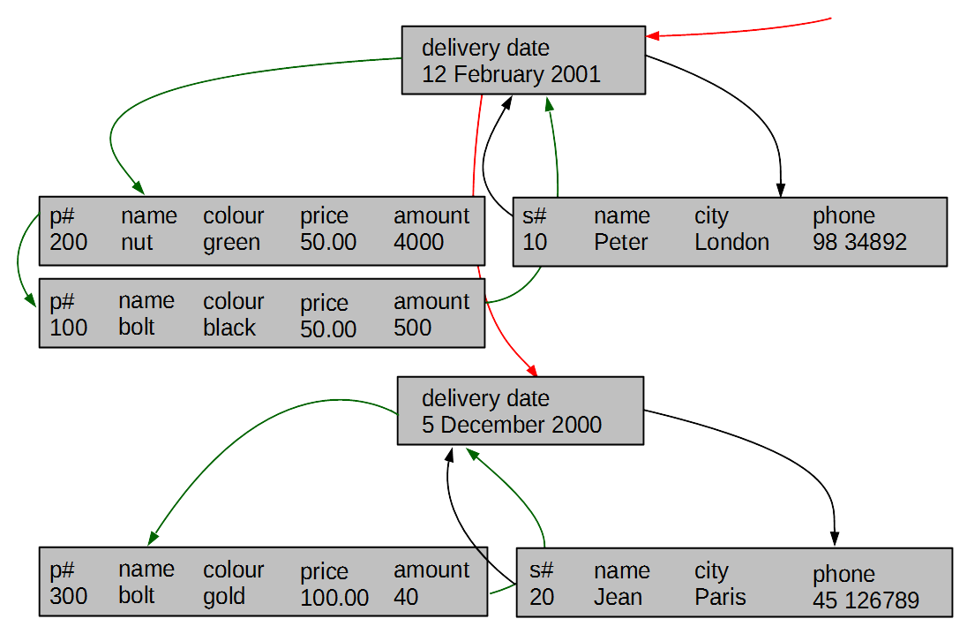
Database systems
Yet another example of a logical view of a database:
- A database contains information about suppliers, parts, and shipments of parts done by suppliers
A logical view above is also called as a network view of data
Notes:
<!-- Brian, Male, British English -->
<speak>
<break time="0.5s"/>
<prosody rate="90%">
Yet another logical view of the database contents is a network view.
<break time="0.3s"/>
In a network view a database consists of records linked with pointers.
<break time="0.3s"/>
All records that contain information about the objects from the same class, for example, suppliers, are linked into a circular linked list.
<break time="0.3s"/>
The links between the records from different circular linked lists represent the links between the objects that belong to different classes.
<break time="0.3s"/>
For example, a link between a record describing suppliers, and a record describing shipment, represents a fact, that a supplier performed a shipment.
<break time="0.3s"/>
</prosody>
</speak>
Systems Analysis

Slide 14

Database systems
Abstraction levels:
Hardware level: bit, byte, sector, track, cylinder
Physical level: byte, data block, sequence of data blocks
File level: field, address of field, record, file
Logical level: attribute, value, row, column, link, table, hierarchy, network
Conceptual level: object, property, value, link, class of objects, association
Notes:
<!-- Brian, Male, British English -->
<speak>
<break time="0.5s"/>
<prosody rate="90%">
Now it is a good time for a short summary of different views of the database contents we presented so far.
<break time="0.3s"/>
The contents of a database can be viewed at a number of different abstraction levels.
<break time="0.3s"/>
At a hardware level (the lowest level of abstraction) the contents of a database is a sequence of bits, grouped into bytes, sectors, tracks and cylinders.
<break time="0.3s"/>
At a physical level, a software used to operate the hardware devices provide the users with a view of a database as a sequence fixed size data blocks each one consisting of a sequence of bytes.
<break time="0.3s"/>
Another layer of software, provides a view of a database as a collection files that consist of records.
The records consist of fields with data.
It is a file view of a database and it is commonly available in many of the procedural programming languages.
<break time="0.3s"/>
Yet another layer of software, creates the logical views of a database, that consists of the tables with rows filled with the sequences of values, or hierarchies or networks of records linked with pointers.
These are so called, tabular, hierarchical, and network data models.
<break time="0.3s"/>
At the highest level of abstraction (conceptual level) the contents of a database are visible as the collections of homogeneous objects, called as classes of objects, described by the attributes (properties) and linked with associations.
This level is usually implemented in object-oriented programming languages as an object-oriented view of data on a top of one of the logical views.
<break time="0.3s"/>
In the future, we shall use a view of a database at a conceptual level and we shall implement it at a logical level as a tabular view of data.
Such approach makes a design of a database independent on a particular logical data model, and it brings a view of the database contents closer to the reality.
<break time="0.3s"/>
</prosody>
</speak>
Systems Analysis

Slide 15
Outline
File Systems
Database Systems
Database Management System
Notes:
<!-- Neural, Brian, Male, British English. -->
<speak>
<break time="0.5s"/>
<prosody rate="90%">
Database management systems.
<break time="0.3s"/>
</prosody>
</speak>
Systems Analysis

Slide 16
Database Management System
Database Management System (DBMS) is a software system that allows its users to define, to create, to maintain, and to control access to a database
DBMS implements the following languages:
- Data Definition Language (DDL) allows the users to specify database structures at either conceptual or logical levels
- Data Manipulation Language (DML) allows the users to insert, modify, delete the contents of a database at either conceptual or logical levels
- Query Language (QL) allows the users to retrieve the contents of a database at either conceptual or logical levels
- Access Control Language (ACL) allows the users to determine many different levels of access to data at either conceptual or logical levels
- Database Administration Language (DAL) allows the users to administer database at either logical or physical levels
Notes:
<!-- Neural, Brian, Male, British English. -->
<speak>
<break time="0.5s"/>
<prosody rate="90%">
Database Management System, commonly abbreviated as DBMS, is a software system that allows its users to define, to create, to maintain, and to control access to a database.
<break time="0.3s"/>
Database Management System implements the following languages: data definition language,(DDL), data manipulation language,(DML) query language, access control language, and database administration language.
<break time="0.3s"/>
Data definition language allows the users to formally determine the database structures at a logical level.
<break time="0.3s"/>
Data manipulation language allows the users to insert, modify, delete the contents of a database.
<break time="0.3s"/>
Query language allows the users to search the contents of a database.
<break time="0.3s"/>
Access control language allows the users to determine many different levels of access to data at a logical level.
<break time="0.3s"/>
Database administration language allows the users to administer database at either logical or physical levels.
<break time="0.3s"/>
</prosody>
</speak>
Systems Analysis

Slide 17
Database Management System
“All people of Database Management Systems”
- System analyst [ˈænəlɪst]
- Database designer
- Application developer
- Database administrator
- Security administrator
- End-user
Notes:
<!-- Neural, Brian, Male, British English. -->
<speak>
<break time="0.5s"/>
<prosody rate="90%">
Database management systems are a one of the most complex software systems implemented over the many years.
<break time="0.3s"/>
The complexity of a database management systems, and its efficient applications requires involvement of the various and highly skilled computing and information technology experts.
<break time="0.3s"/>
A database management system needs highly qualified system analysts and database designers to find the appropriate applications of a system in an enterprise, and to correctly design the conceptual, logical, and physical structures of a database.
<break time="0.3s"/>
Implementation of database applications needs highly skilled application developers and database programmers.
<break time="0.3s"/>
Smooth and seamless applications of a database management systems at production stages, requires well qualified database and data security administrators.
<break time="0.3s"/>
At the moment, database systems are used almost everywhere, and because of that all of us also belong to a group of so called "database people" as the end users of database systems.
<break time="0.3s"/>
</prosody>
</speak>
Systems Analysis

Slide 18
Database Management System
Advantages of Database Management Systems
- Control of data redundancy
- Control of data consistency
- Sharing of data
- Improved security
- Improved performance (not always)
- Increased productivity
Notes:
<!-- Neural, Brian, Male, British English. -->
<speak>
<break time="0.5s"/>
<prosody rate="90%">
Database management systems have a lot of advantages over traditional file systems.
<break time="0.3s"/>
The appropriate database design techniques, supported by database software, allow for elimination of redundancie,s and automatic control of data consistency and integrity.
<break time="0.3s"/>
Sophisticated concurrency control and transaction processing subsystems, incorporated into database management systems, support correct and concurrent sharing of data by many users.
<break time="0.3s"/>
A central management of data at a logical level, allows for significantly improved data security.
<break time="0.3s"/>
A standarized data definition, data manipulation and query languages allow for fast implementation of efficient database applications.
<break time="0.3s"/>
Various tools available within a database management systems, like data loaders, data cleaning tools, data compression tools, data application generators, and the others, significantly increase productivity, in the environments where storing accessing and using data is of prime importance.
<break time="0.3s"/>
</prosody>
</speak>
Systems Analysis

Slide 19
Database Management System
Disadvantages of Database Management Systems
- Complexity
- Size
- Running and maintenance costs
- Performance
- Incompatibilities between different systems
- High cost of failure
Notes:
<!-- Neural, Brian, Male, British English. -->
<speak>
<break time="0.5s"/>
<prosody rate="90%">
Database management systems have some disadvantages that limits a scope of their applications.
<break time="0.3s"/>
In the past we called a database management system as a complex software system, and its complexity is one of the main disadvantages.
<break time="0.3s"/>
A database management system is too complicated too large to be applied for implementation of simple applications that process small amounts of data.
<break time="0.3s"/>
Complexity of a database system also contributes to the high running and maintenance costs.
<break time="0.3s"/>
Implementation of a logical view of data, requires implementation of additional software on top of operating system files.
It increases a data transfer path from physical storage, through operating system buffers, to data buffer caches of a database system.
<break time="0.3s"/>
As a consequence, it decreases performance of the system.
For example, a direct implementation of database system, on top of physical persistent storage devices and bypassing operating system can increase performance by approximately 20 percent.
<break time="0.3s"/>
A failure of the system due a hardware or software fault, may require a quite long period of time to undo the outcomes of incomplete transactions, redo complete and not permanently recorded outcomes of completed transactions and recover a database to a consistent state.
<break time="0.3s"/>
</prosody>
</speak>
Systems Analysis

Slide 20
References
C. Coronel, S. Morris, A. Basta, M. Zgola, Data Management and Security, Chapter 1, Cengage Compose eBook, 2018, eBook: Data Management and Security, 1st Edition
T. Connoly, C. Begg, Database Systems, A Practical Approach to Design, Implementation, and Management, Chapter 1 Introduction to Databases, Pearson Education Ltd, 2015
Notes:
Systems Analysis

